Slide 1
Lessons Learnt Lecture: Contract Management
Patrick Flynn
Director of Compliance and M&E
25 February 2022

Slide 2
What we’ll cover today
Who we are and what we do
How we put together and appoint contractors
Our approach to contractor management
Our challenges
Incorporating feedback and making positive changes to our services
Resident involvement opportunities

Slide 3
Who we are
Customer Services Directorate
Asset Management Department
Technical Services
Compliance and M&E
50 people work on contract management daily
Type of works:
Reactive repairs
Servicing and cyclical maintenance
Void works
Capital programmes

Slide 4
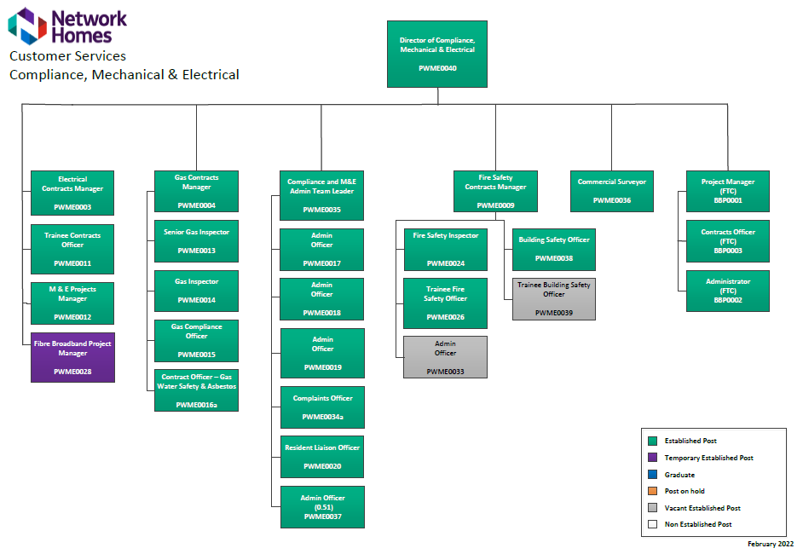

Slide 5
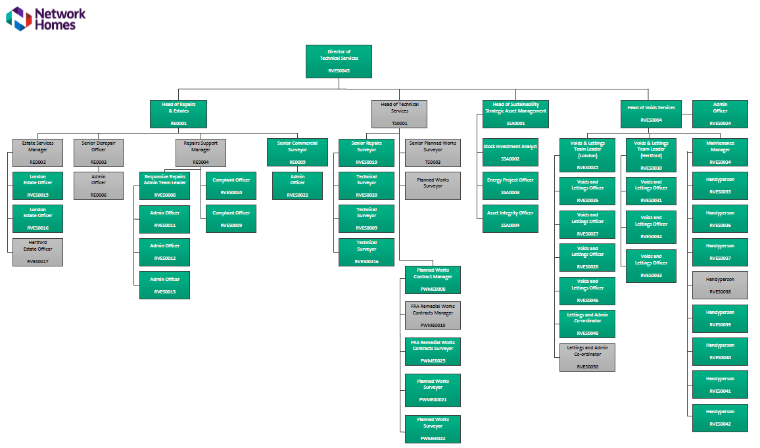

Slide 6
Our partners

Slide 7
New contracts
Revise and renew specification
What form of contract should be used?
Quality and cost submission
Legislative thresholds and standing orders
Impartial evaluation
Consultation
Appointment and mobilisation
IT integration

Slide 8
Our approach
Maximise communication – daily catch ups
Weekly WIP meetings
Weekly compliance reviews
Monthly contract meetings
Quarterly core groups
Annual review meeting
High profile meetings
Maximising IT system integration
Firm but fair, open, transparent, dynamic, don’t shy away, empower team

Slide 9
Our challenges
Contractor underperformance
Lack of accountability
Poor financial control
Increase in complaints and dissatisfaction
External industry pressures

Slide 10
Incorporating feedback
Service improvement plans
Discussing complaints and survey responses in detail
Central and local complaint team input
Involving residents in discussions about complex issues
High profile meetings

Slide 11
Scenarios
Lack of communication (NH responsibility) – communal heating and hot water system leaks
Contractor delays and poor communication
NH internal communication processes – supporting Contact Centre as first point of contact
Residents chasing progress of lift repairs
Alternative heating and hot water

Slide 12
Resident involvement
Input into contract specification
Evaluating tender submissions
Attending contract meetings
Complaints and satisfaction surveys
Estate inspections and visits
Resident panels and forums

